Slide 1
Transparent Data Encryption - باللغة العربية
Ayman El-Ghazali

Slide 2
Agenda
What is TDE Audit?
Architecture
How to Set it up
Demo

Slide 3
Transparent Data Encryption (TDE)
Introduced in SQL 2008 – Enterprise Edition Feature
Any database with TDE Enabled Automatically has its backup encrypted
Backup Encryption without TDE is supported on Standard Edition of SQL Server 2014+
Database backups must be restored using Encryption Certificate
This secures data from theft
Data is encrypted “at rest” therefore any user with access to the live database can view the data

Slide 4
Transparent Data Encryption
TempDB is automatically Encrypted when TDE is setup on any user database
Backup compression will not work due to database being encrypted
CPU usage can increase slightly in order to compensate for Encryption/Decryption of pages as they are read into Memory
Encrypts all Data and Log files belonging to the Database
Database using Buffer Pool Extension will need to have Disk level encryption setup
Data in Memory Optimized Filegroups is not Encrypted

Slide 5
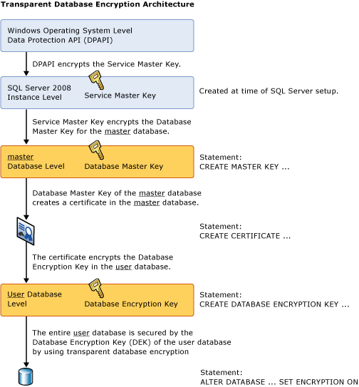
TDE Architecture
https://msdn.microsoft.com/en-us/library/bb934049.aspx

Slide 6
Basic Setup for TDE
Use Master Go
Create Master Key Encryption By Password = 'Pa$$w0rd'
Create Certificate [CertificateName] with Subject = 'Certificate Subject'
Use [DatabaseToBeEncrypted] Create Database Encryption Key With Algorithm = { AES_128 | AES_192 | AES_256 | TRIPLE_DES_3KEY } Encryption by Server Certificate [CertificateName]
Alter Database [DatabaseToBeEncrypted] Set Encryption ON

Slide 7
Demo
Transparent Data Encryption

